Slide 1




Chain Game
CME1252 Project based learning - II
Computer Engineering
Prepared by:
BAHADIR SEMİH KORKMAZ - 2021510044
ABDULLAH DEMİRCİ - 2021510025
YASAMIN VAISHARIATPANAHI - 2022510013
ABDULKADIR CAN - 2021510020
GÖKBERK SARI - 2018510155
ELİF DORUK - 2021510026
TALHA MUSTAFA ANTEP - 2021510122
IZMIR - 29/05/2023

Slide 2


OUTLINE
INTRODUCTION
PROGRESS SUMMARY
Requirements
Task sharing
Scheduling
Completed Tasks
Incomplete Tasks: Reasons, Explanation
Additional Improvements
ALGORITHMS AND SOLUTION STRATEGIES
SCREENSHOTS
PROBLEMS ENCOUNTERED
CONCLUSION
REFERENCES

Slide 3


Introduction
Chain, an exciting and strategic number game that will put your mathematical skills to the test. Our goal with this project was to develop a captivating game where players construct number chains to achieve the highest possible score.

Slide 4



PROGRESS SUMMARY
TASK SHARING
REQUIREMENTS
SCHEDULING
BAHADIR: Basic of the code, Game Field, HUD, Cursor Movement, SLL, Chain Constructing, Control, Score, Code Merging
YASAMIN: Design of Classes, Menu, Board Game, Screen, Seed, + Movement, DLL, High score Table, Presentation, Code Merging
ABDULLAH: MultiLinkedList Class, Chain Table
TALHA: Data Structures and Classes, Game Field, Chain, Poster
ELİF: Class design ,Chain table, Highscore table
Eclipse Application
JAVA: Program Language
Object Oriented Programming
Single Linked List
Multiple Linked List
Double Linked List
Week 1: Design of classes, data structures. Screen. Menu. Board initialization.​
Week 2: Chain constructing. Chain control. Scoring. Updating board.​
Week 3: Table. High Score Table. Remaining parts of the game, debugging/testing.

Slide 5

PROGRESS SUMMARY
COMPLETED TASAK
Additional Improvements
INCOMPLETED TASAKS: Reasons, Explanation
Menu
Board initialization
Chain Construction, Control
Scoring
Updating Board
Table
High Score Table
No additional improvement has been added to the project.
Every task has been done according to the plan.

Slide 6

ALGORITHMS AND SOLUTION STRATEGIES
Game Initialization:
Fill the 10x16 board with numbers 1, 2, 3, or 4 randomly and equally with space between them.
Optionally, allow the player to set a random number seed for consistent gameplay.
Game Mechanism:
Strategic construction of chains using plus signs in each round.
Chain rules: one chain per round, connected squares with plus signs, 1 difference between neighboring squares, minimum of four squares.
Chain score is calculated as n^2, where n is the number of elements in the chain.
Valid chains are added to the table, disappear from the board, and contribute to the player's overall score.
The game ends if the chain is incorrect or too short.
End of the Game and High Score Table:
The player can exit the game by pressing the E key.
After the game concludes, the High Score Table is displayed in descending order, showcasing the top scores achieved by players.
The default High Score Table is stored in the "highscore.txt" file, in descending order.

Slide 7
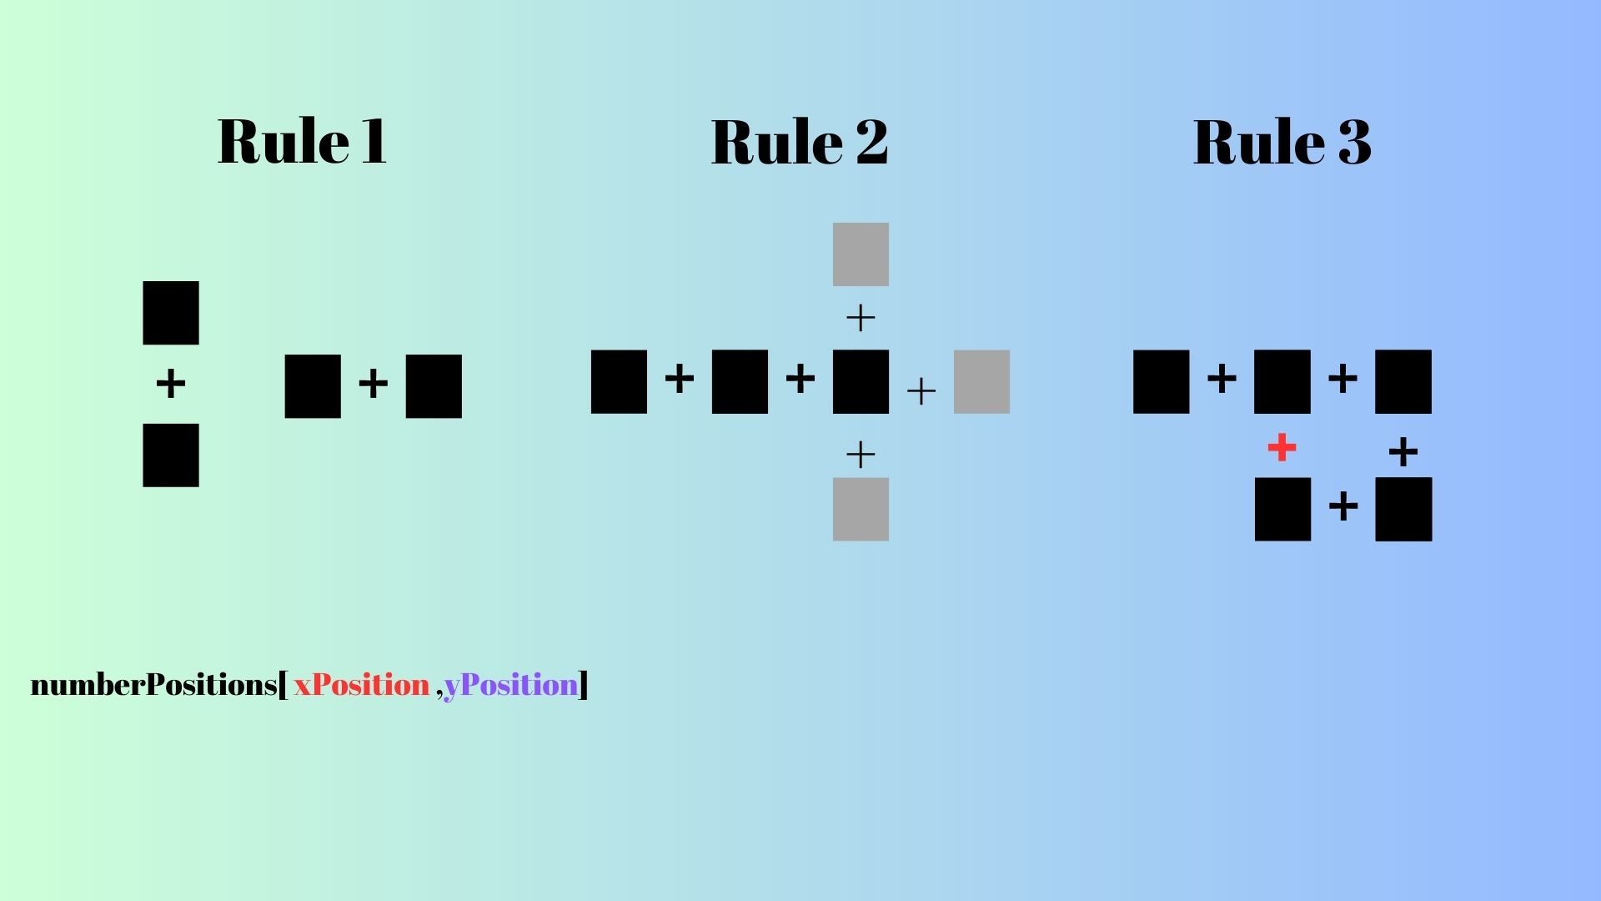
ALGORITHMS AND SOLUTION STRATEGIES

Slide 8



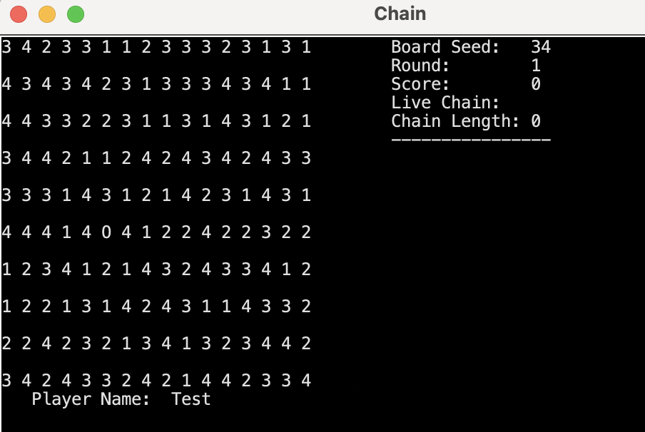
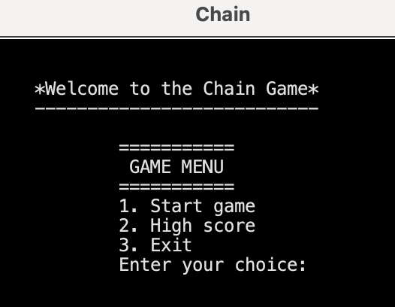
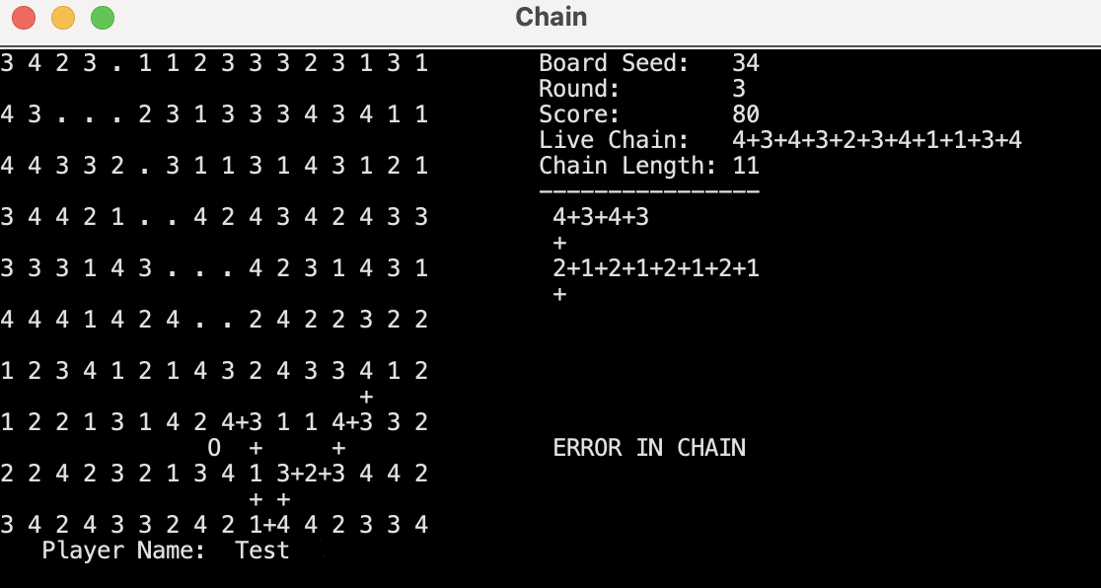
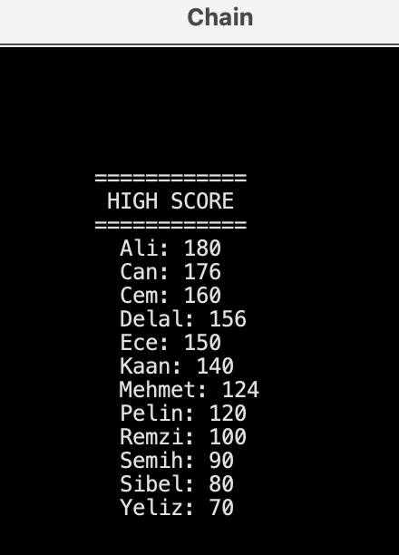
SCREENSHOTS

Slide 9

PROBLEMS ENCOUNTERED
Complex chain construction: Challenges in strategic chain construction.
User interface: Interface design requires enhancements for improved usability and player experience.​
Error handling: Clear feedback needed for error identification and correction in chain constructions.​
Difficulty level adjustment: Adjustable difficulty levels enhance player engagement and cater to different skill levels.​
Lack of visual feedback: Visual cues aid in recognizing valid chain formations and informing strategic decisions.​
Lack of communication due to online studying: Challenges in team communication and collaboration due to remote learning.

Slide 10

CONCLUSION
Chain is a strategic number game where players construct chains on a 10x16 board to achieve the highest score. By following specific rules and strategically placing plus signs, players create connected chains with a minimum length of four squares. Each chain's score is based on the square count squared. Valid chains are added to the table, contributing to the player's overall score. With its intuitive gameplay mechanics, Chain provides a challenging and addictive experience that encourages strategic thinking and decision-making. Players of all ages can enjoy the endless possibilities and compete for a spot on the High Score Table.

Slide 11
REFERENCES
Herbert Schildt The Complete Reference Java Seventh Edition
C. Thomas Wu an introduction to Object-Oriented Programming with java
https://www.java.com/tr/
https://dev.java
https://www.eclipse.org
https://pitch.com​

Slide 12

Thank you for listening !

